Slide 1

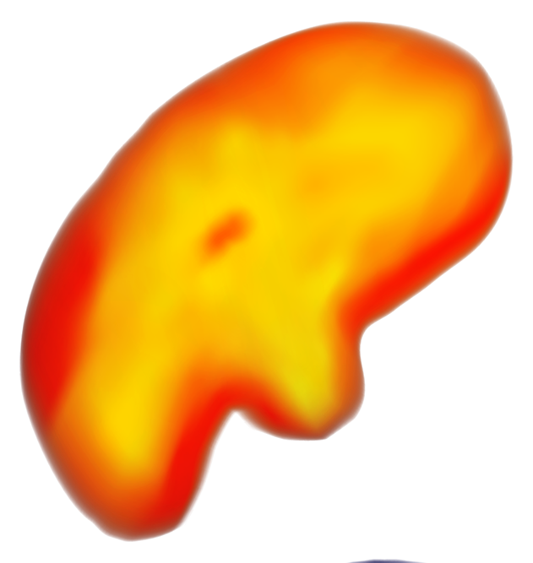
TACKLING WEATHER PREDICTION DATAHACK 2025
Team 16: INIT to WIN IT Siddhant Singh, Molly Du, Bolong Tang, Hung Dang

Slide 2
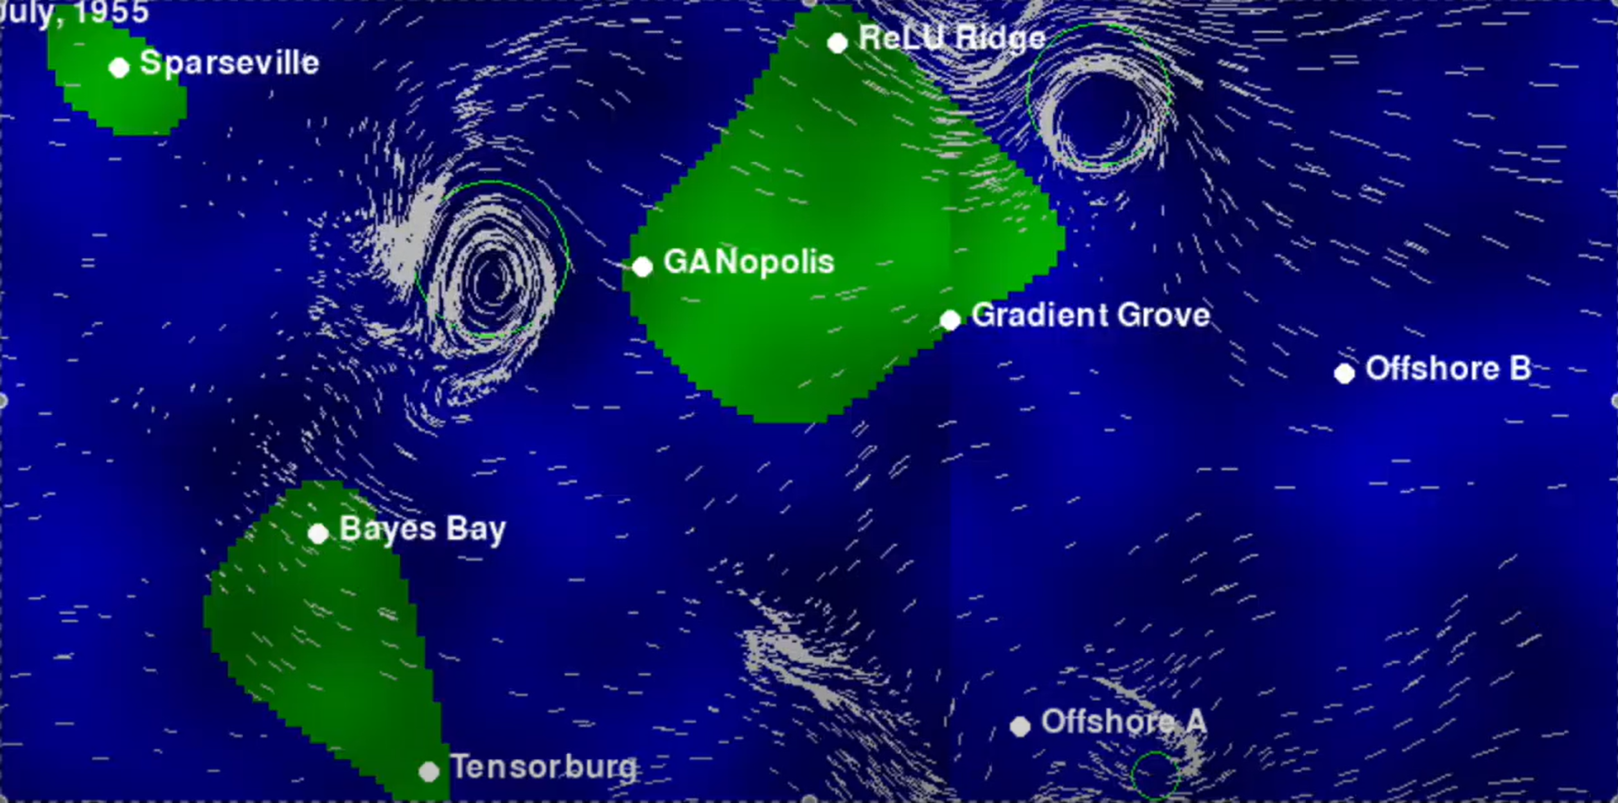





Slide 3
OBJECTIVES
1.
2.
known
unknown
Predict 5 days of Wind Speed in GANopolis given preceding 5 days for 10 events
?
?
?
?
?
D1
D2
D3
D4
D5
D6
D7
D8
D9
D10
{
Insurance Price
Select insurance price for latter 5 days to maximize profit
Damages
Profit

Slide 4
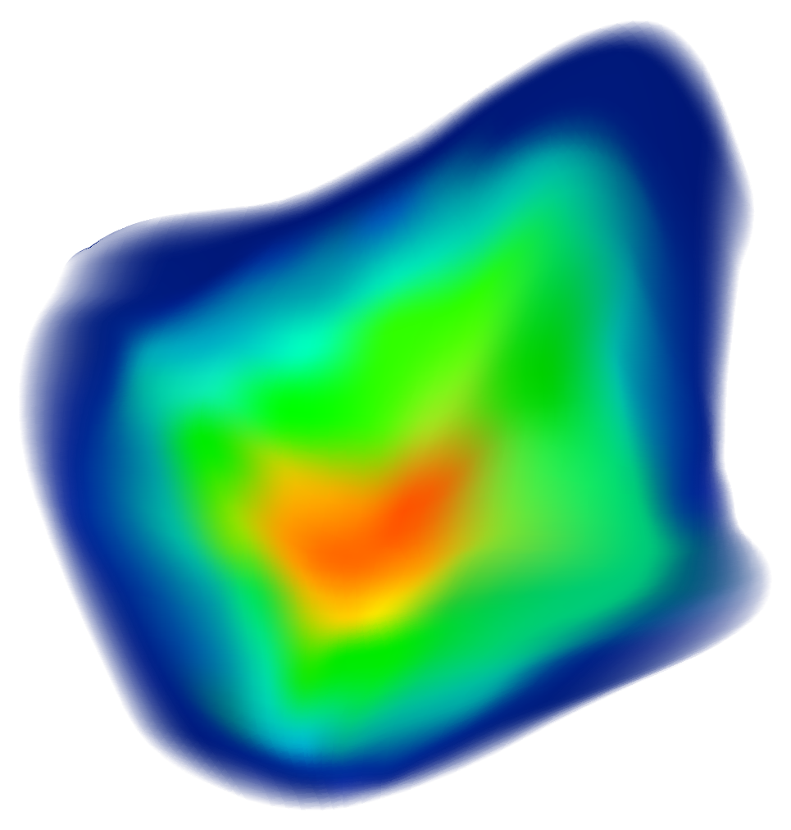
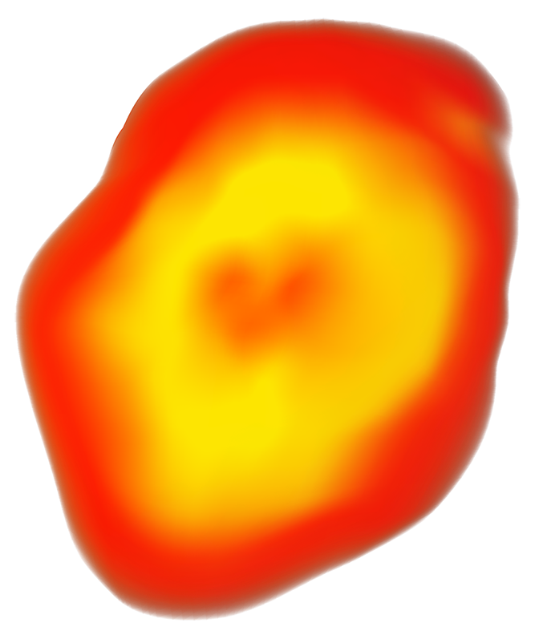
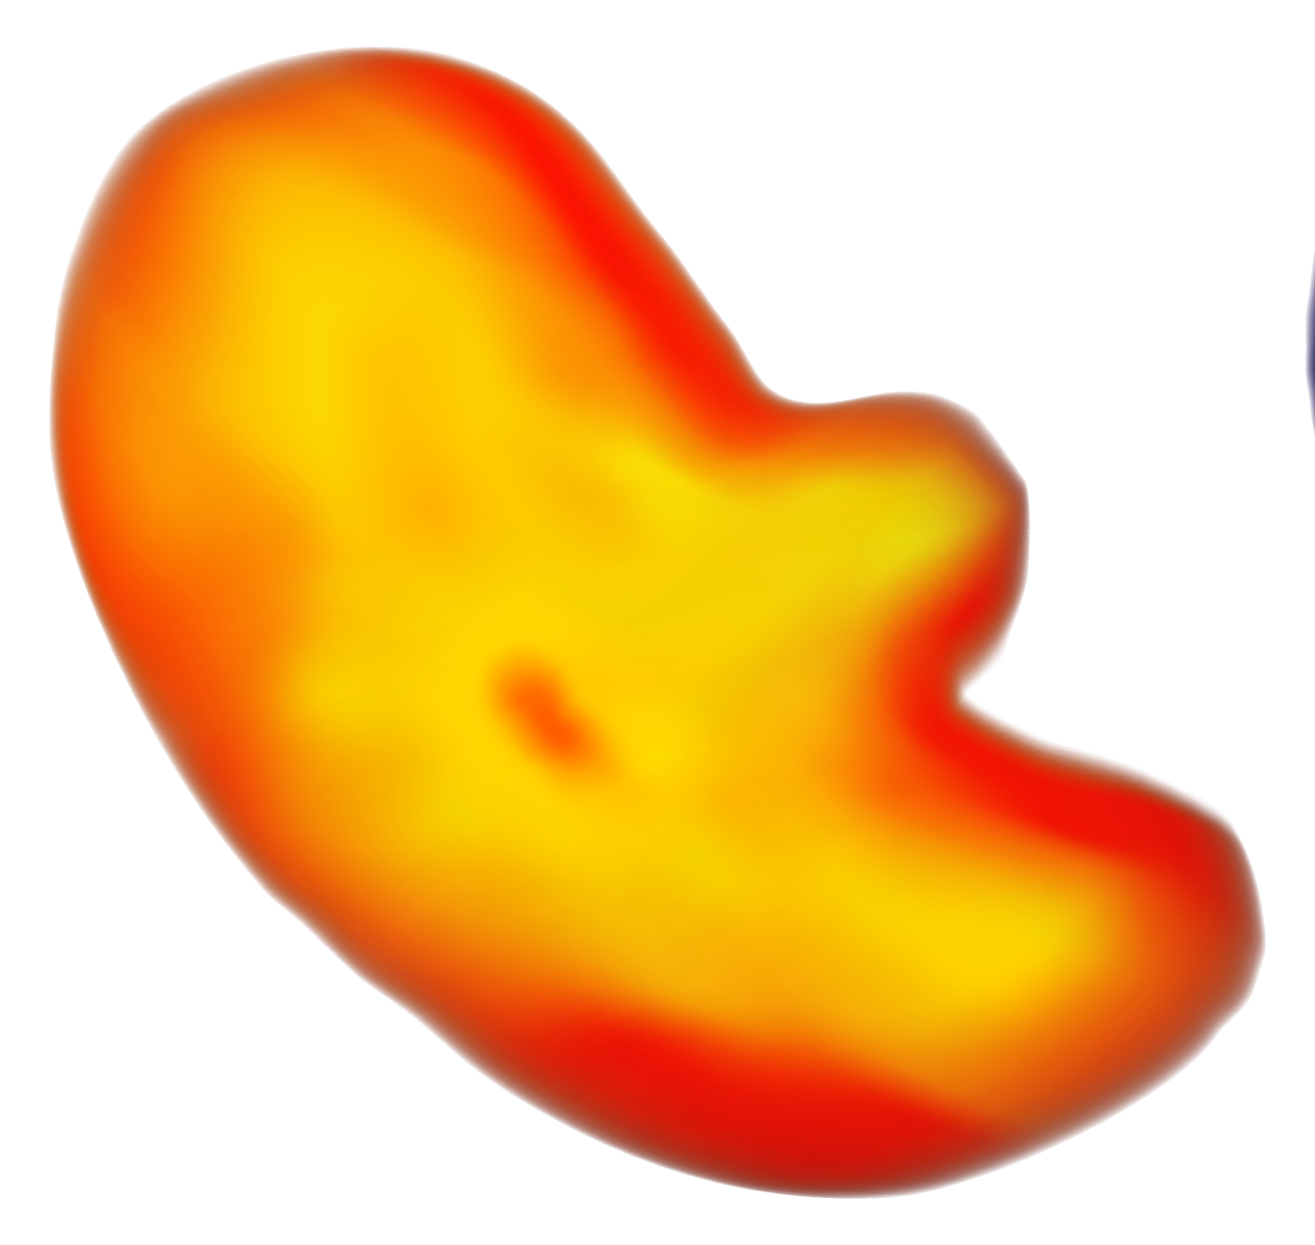
01
DATA VISUALIZATION

Slide 5
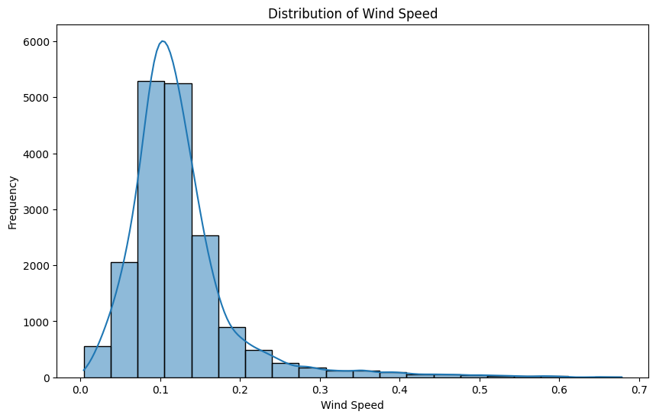
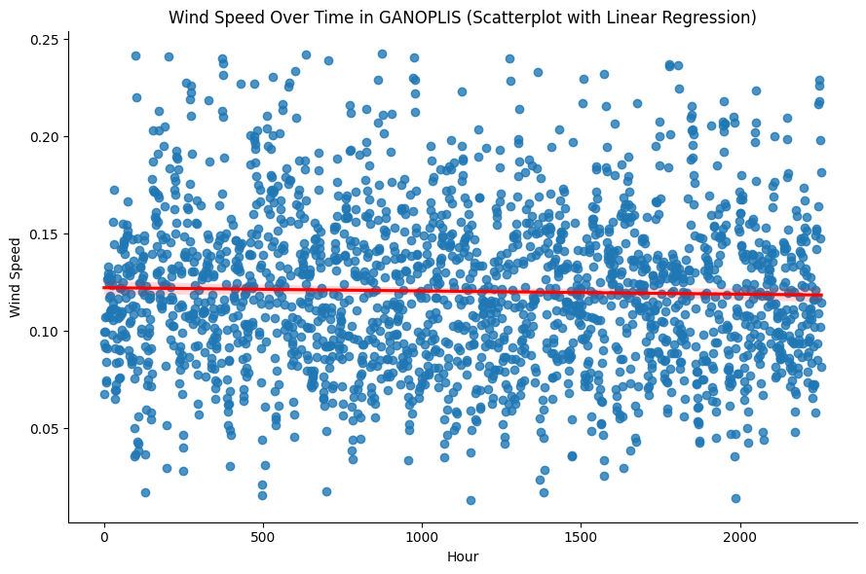
Wind Speed Visualization
DISTRIBUTION OF WIND SPEED
WIND SPEED OVER TIME in GANopolis
Notes:
Typical wind speed falls between___ and ___. The data is skewed to the right.

Slide 6
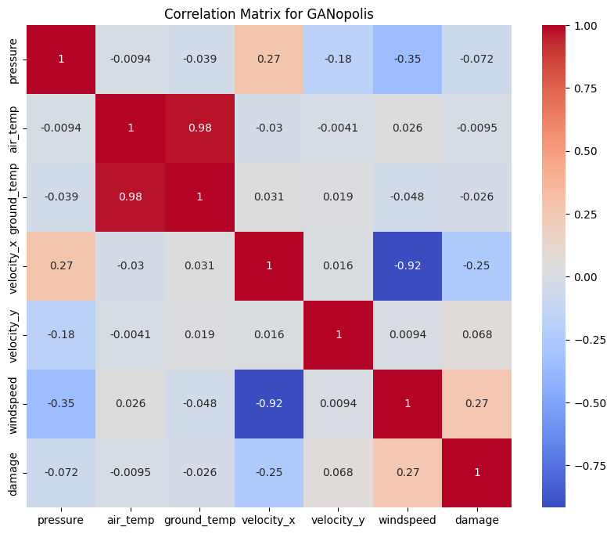
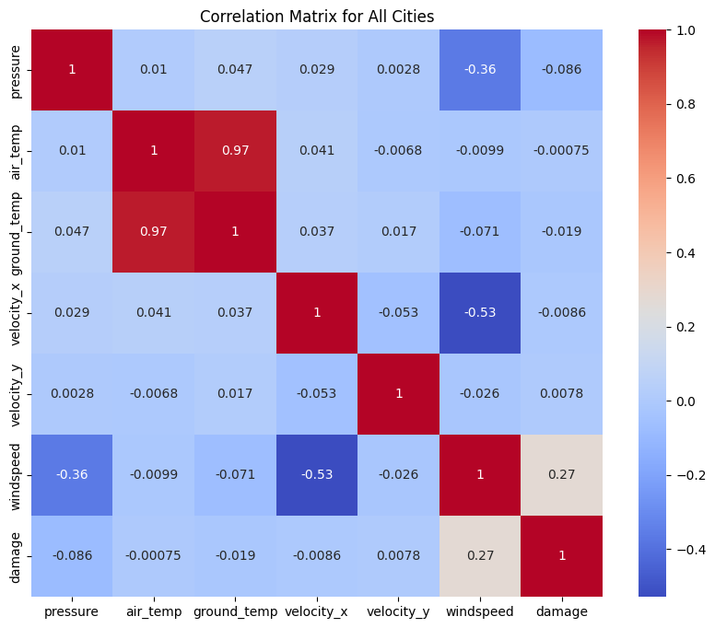
Correlation Matrices
GANopolis
All Cities

Slide 7
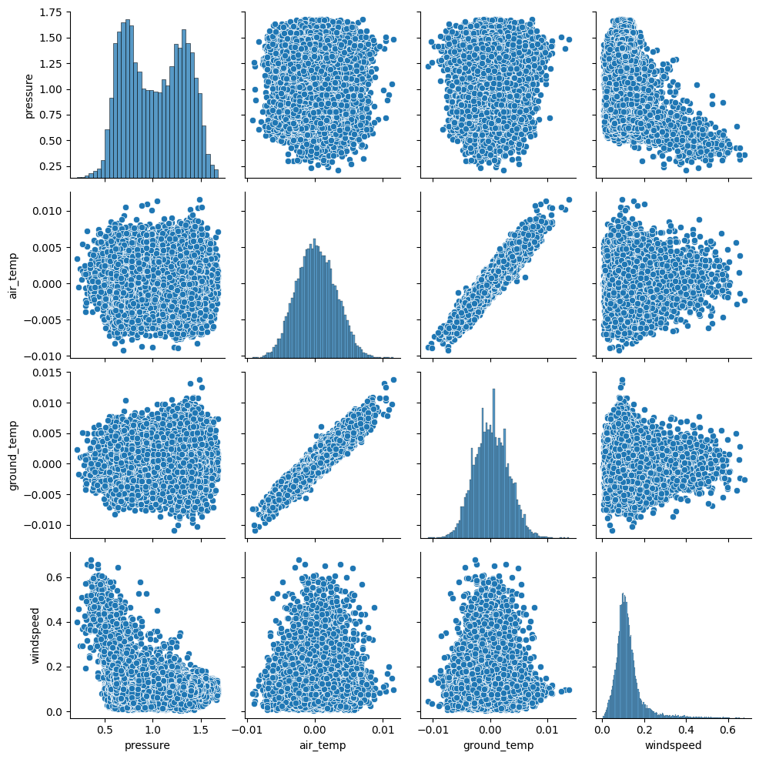
PCA Reduction Visualization
PCA
Transforms data into principal components so patterns can be detected
Can see more detailed patterns than simple correlation in a correlation matrix

Slide 8
02
MACHINE LEARNING
Notes:
Now that we’ve gone over how the model performs with training data, let's talk about our results in the 10 given event data sets

Slide 9
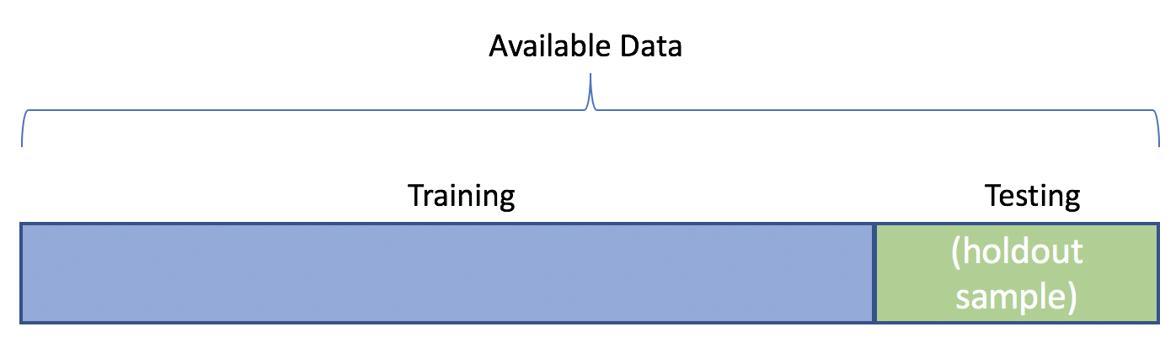
70%
30%

Slide 10
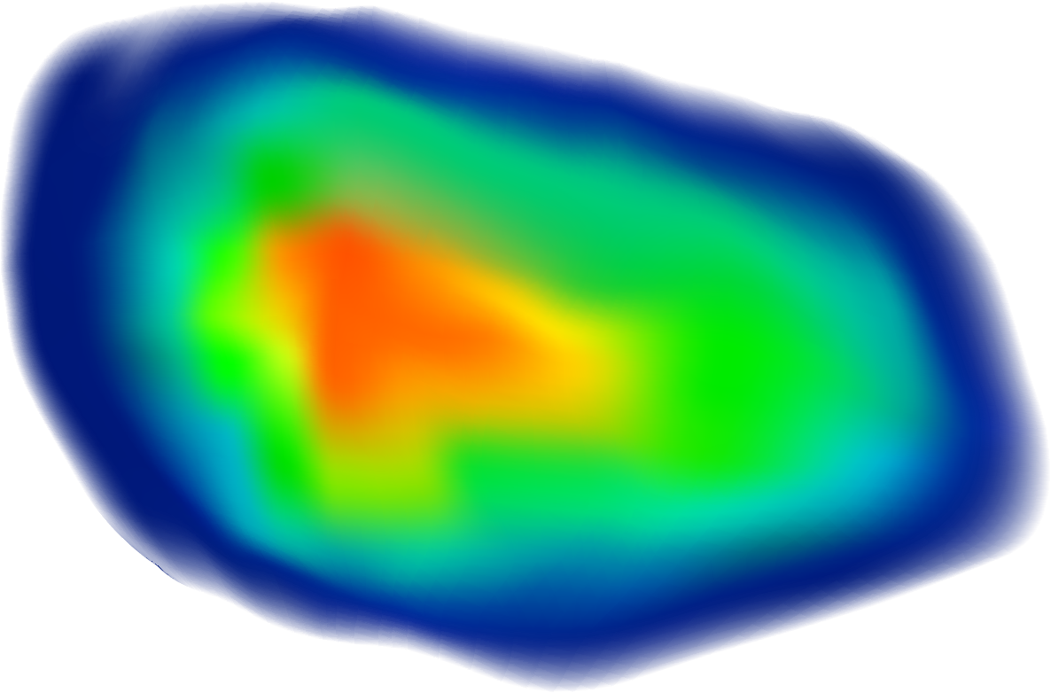
The XGBoost Model

Slide 11
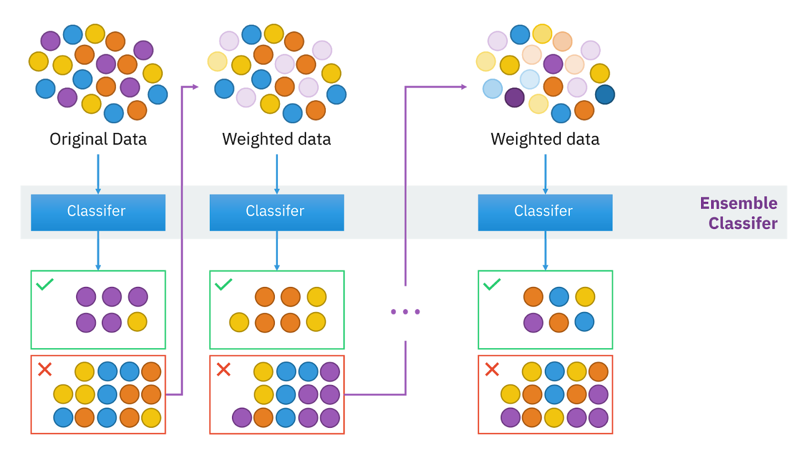

Slide 12
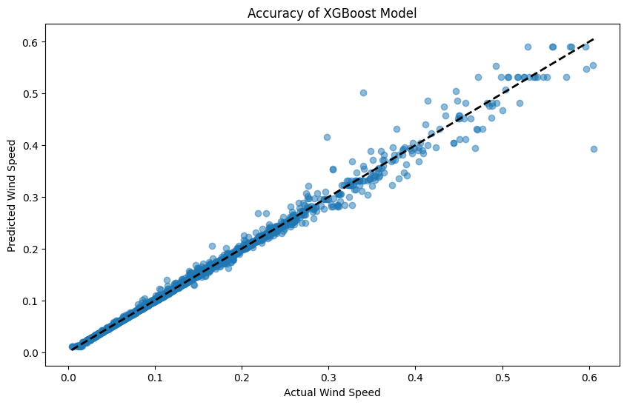
XGBoost Model Results
Training Score:
R² = ~0.993
Test Score:
R² = ~0.991

Slide 13
03
INSURANCE PRICE

Slide 14
Our results.
Insurance Price per Person over 10-day Period
Event Number
1 | $250.40
2 | $250.94
3 | $251.48
4 | $250.51
5 | $251.47
6 | $251.84
7 | $250.40
8 | $251.46
9 | $250.41
10 | $251.52

Slide 15
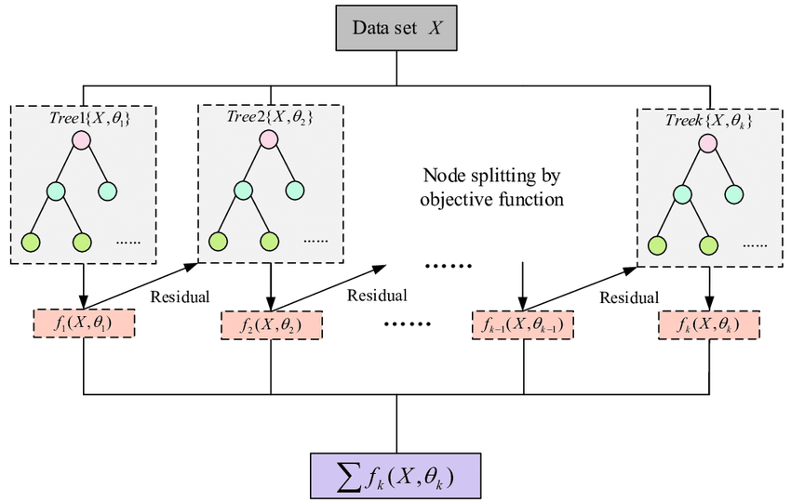
Wind Speed Prediction
XGBoost predicts hourly wind speeds using weather data and time patterns
Notes:
Using x_velocity and damage variables

Slide 16
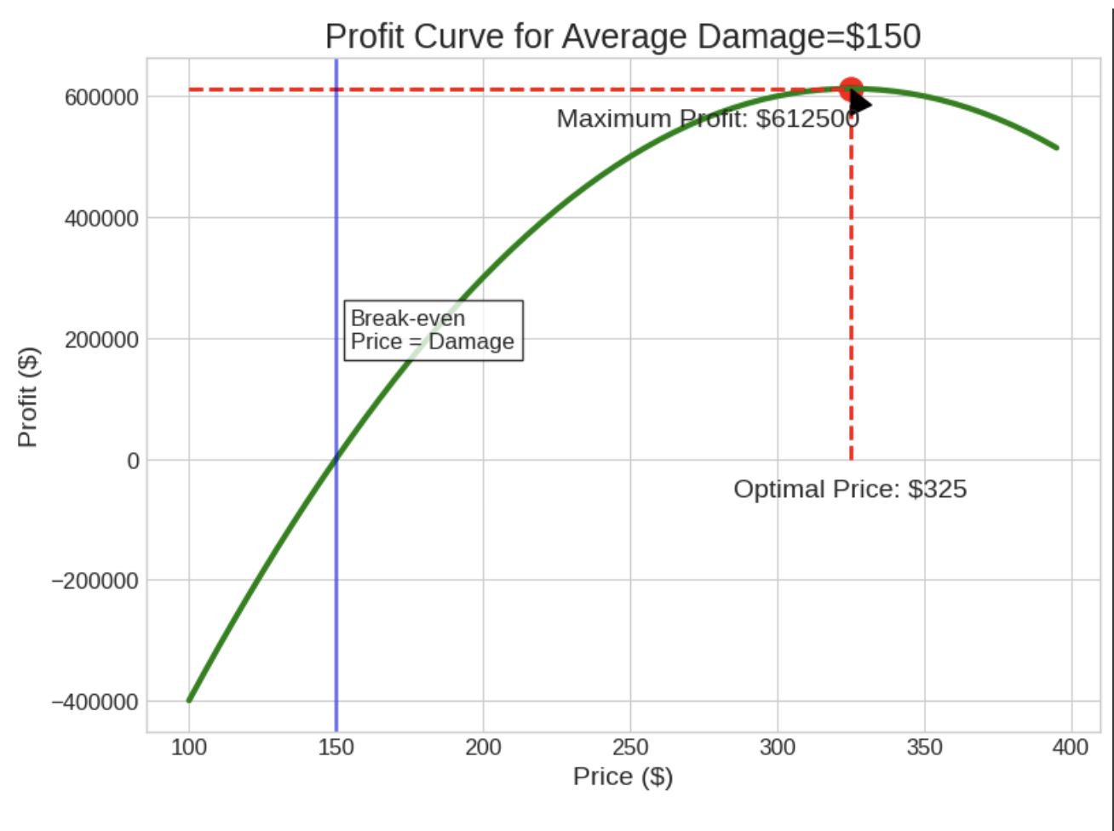
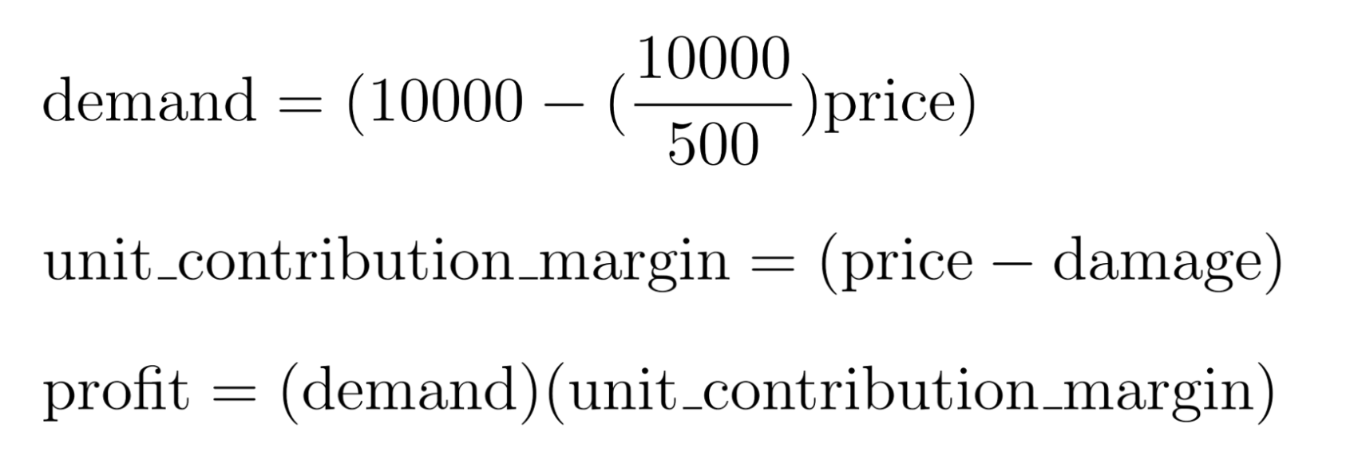
What we’re doing…
Damage Analysis
Calculates average damage costs from historical data for each event

Slide 17
Price Optimization
Finds the perfect price point that balances:
Higher prices = more profit per customer but fewer customers
Lower prices = more customers but less profit per customer
Low, small profit
High price, low # of customers

Slide 18
Profit Maximization
Profit = (Customers × (Price - Damage))
Automatically identifies the price that generates maximum total profit

Slide 19
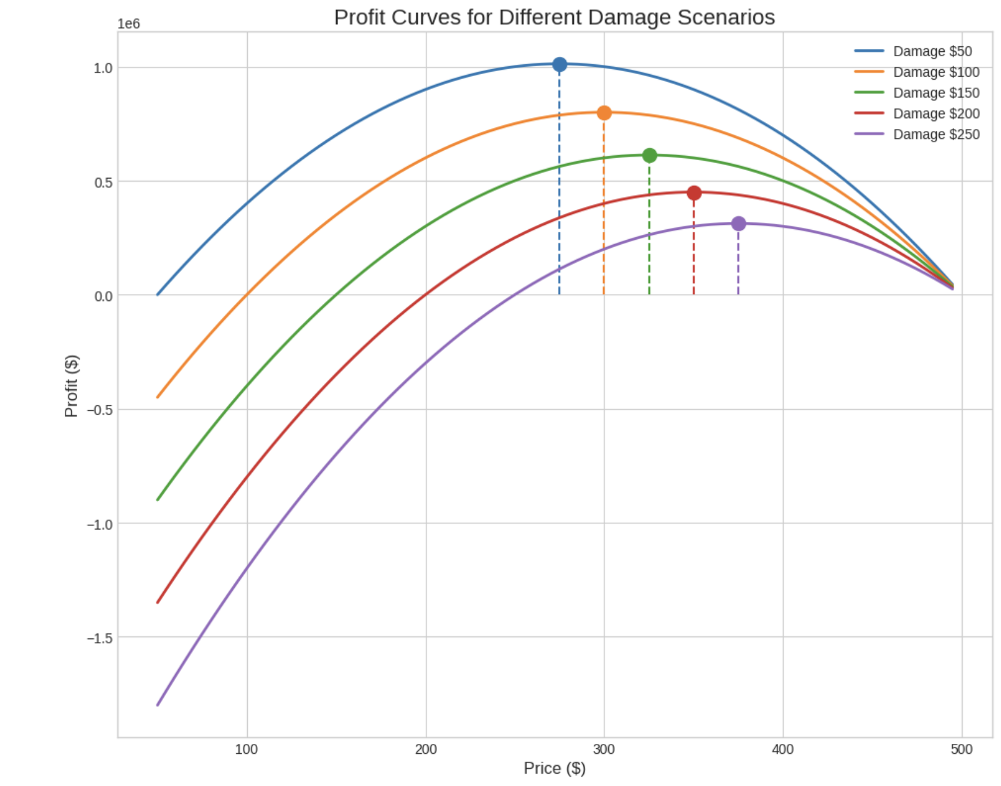
Pricing Formula
Ideal price = ~ $250
(500 + Average Damage) / 2
Mathematically proven to maximize profit based on our demand model

Slide 20
04
CONCLUSION

Slide 21
RECAP
XGBoost Machine Learning Model: 99% Accuracy
Predict wind speed across 10 event instances
Suggest best insurance price for each event
{
Insurance Price
known
unknown
?
?
?
?
?
Damages
Profit
D1
D2
D3
D4
D5
D6
D7
D8
D9
D10
Notes:
Objective 1:
Use XGBoost to train the model
Using xgboost, predict wind speeds across 10 events
Suggest best insurance price
By projecting the future, we can maximize profit

Slide 22
Thank You!
QUESTIONS?

